Slide 1
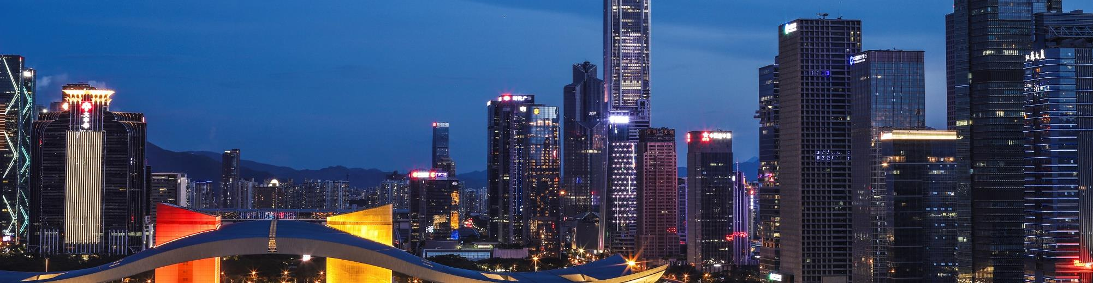
Predicting the Best new restaurant location
12/22/2019
Jingzhou Wang

Slide 2
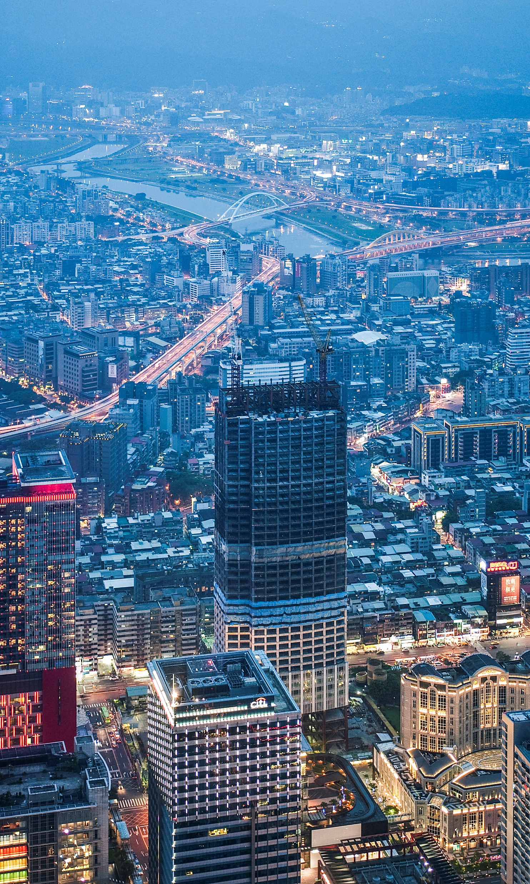
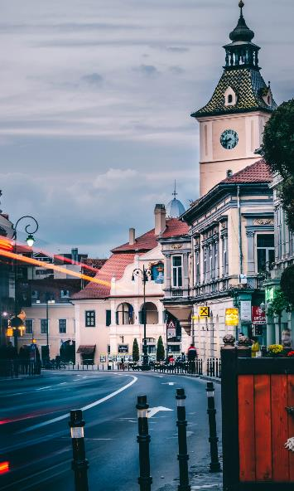
Introduction
In the downtown Toronto, if someone is looking to open a restaurant, where would you recommend that they open it?
In this project, we will only focus on the location and the general atmosphere of the neighborhood for simplicity purpose.

Slide 3
Data acquisition and cleaning
Downloaded data from multiple sources were combined into one table. We should split the data by different postal code area. Firstly, we should got all postal code area information. Then we got the longitude and latitude coordinates data. In the end, we used these data to search how many restaurants in these postal code area.
Data resource
List of postal codes of Canada : https://en.wikipedia.org/wiki/List_of_postal_codes_of_Canada:_M
Four square API: https://developer.foursquare.com/
Longitude and Latitude: http://cocl.us/Geospatital_data

Slide 4
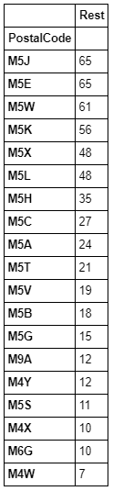
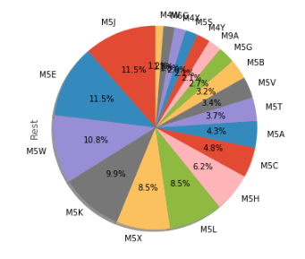
Exploratory Data Analysis
Restaurants tables
Bar table
After data cleaning, there were a lot of restaurants in each postal code area. After we sort the data set. We got:

Slide 5
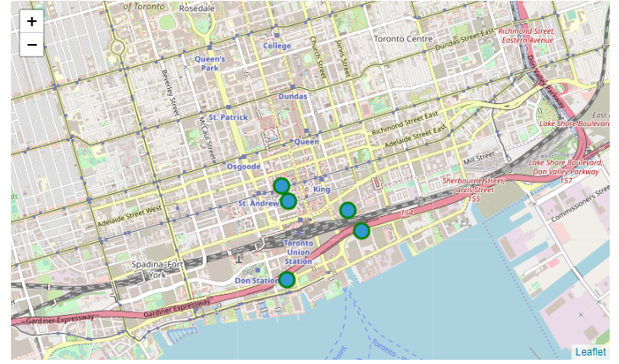
Exploratory Data Analysis
We can easy to find that top 5 restaurant has 50% restaurant in Downtown. Let's show them on the map, let's see where has most of people at downtown.

Slide 6
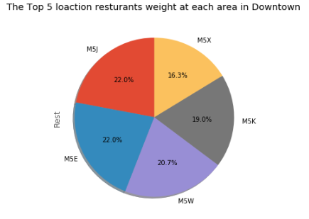
Exploratory Data Analysis
So, we can easy to find the best location to open a new restaurant. It's should be the center of these 5 locations area. Compare with these 5 locations restaurants, we can adjust the center of these 5 groups restaurants by numbers of weights
The best location = top1 weight(Number) + top2 weight(Number) + top3 weight(Number) + top4 weight(Number) + top5 * weight(Number)

Slide 7
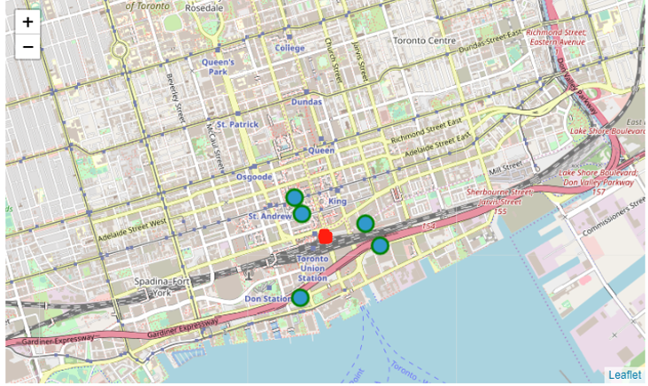
Conclusion
As the picture above, each location has close weight. We just pick the center of these locations, and I suggest the new restaurant should close to the Toronto Union Station.

